Slide 1
Laplace transform and Fourier transform
Rishav Acharya (01/77)
Pratik Joshi (39/77)

Slide 2
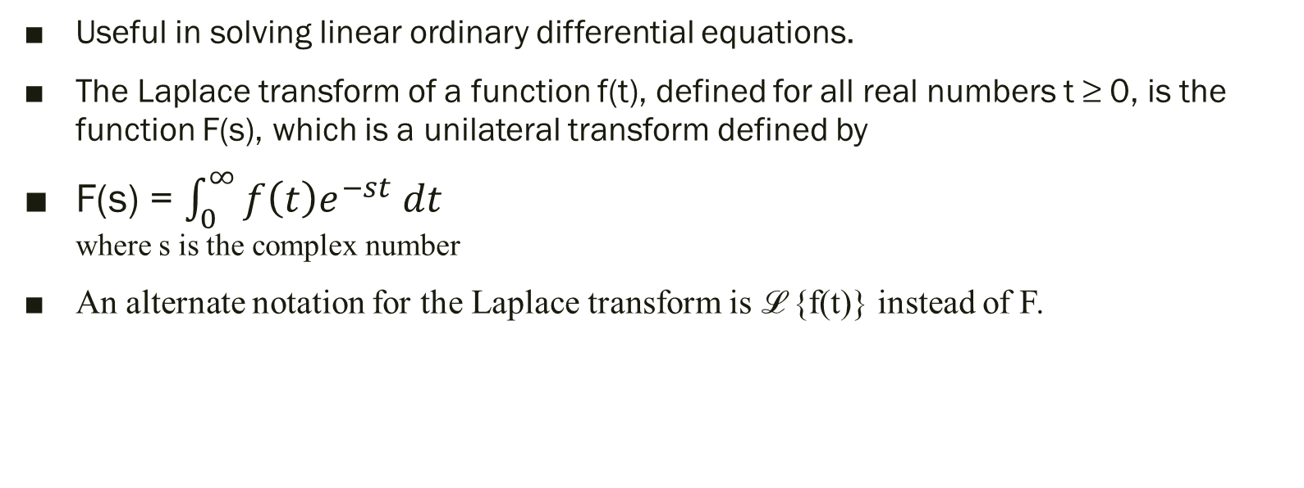
Laplace transform
Useful in solving linear ordinary differential equations.
The Laplace transform of a function f(t), defined for all real numbers t ≥ 0, is the function F(s), which is a unilateral transform defined by
F(s) = $\int_{0}^{∞}{f\left(t\right)e^{−st} dt}$ where s is the complex number
An alternate notation for the Laplace transform is ℒ {f(t)} instead of F.

Slide 3
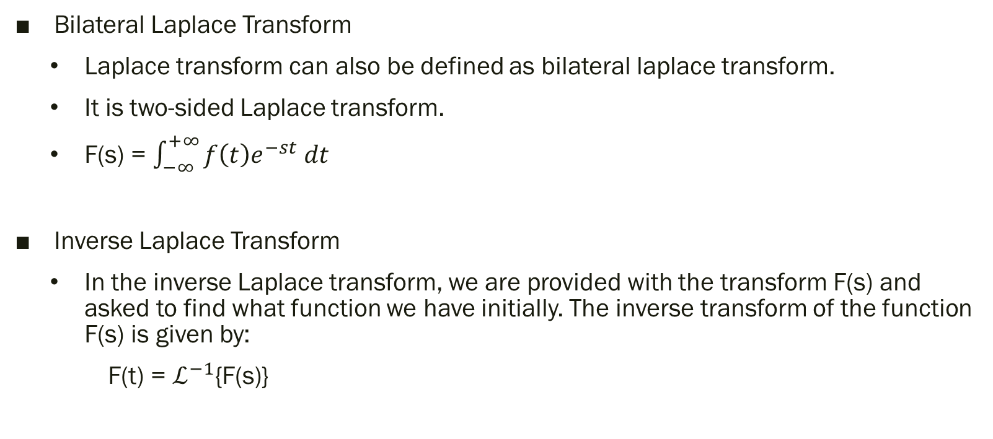
Types of Laplace Transform
Bilateral Laplace Transform
Laplace transform can also be defined as bilateral laplace transform.
It is two-sided Laplace transform.
F(s) = $\int_{−∞}^{+∞}{f\left(t\right)e^{−st} dt}$
Inverse Laplace Transform
In the inverse Laplace transform, we are provided with the transform F(s) and asked to find what function we have initially. The inverse transform of the function F(s) is given by:
F(t) = $ℒ^{−1}${F(s)}

Slide 4
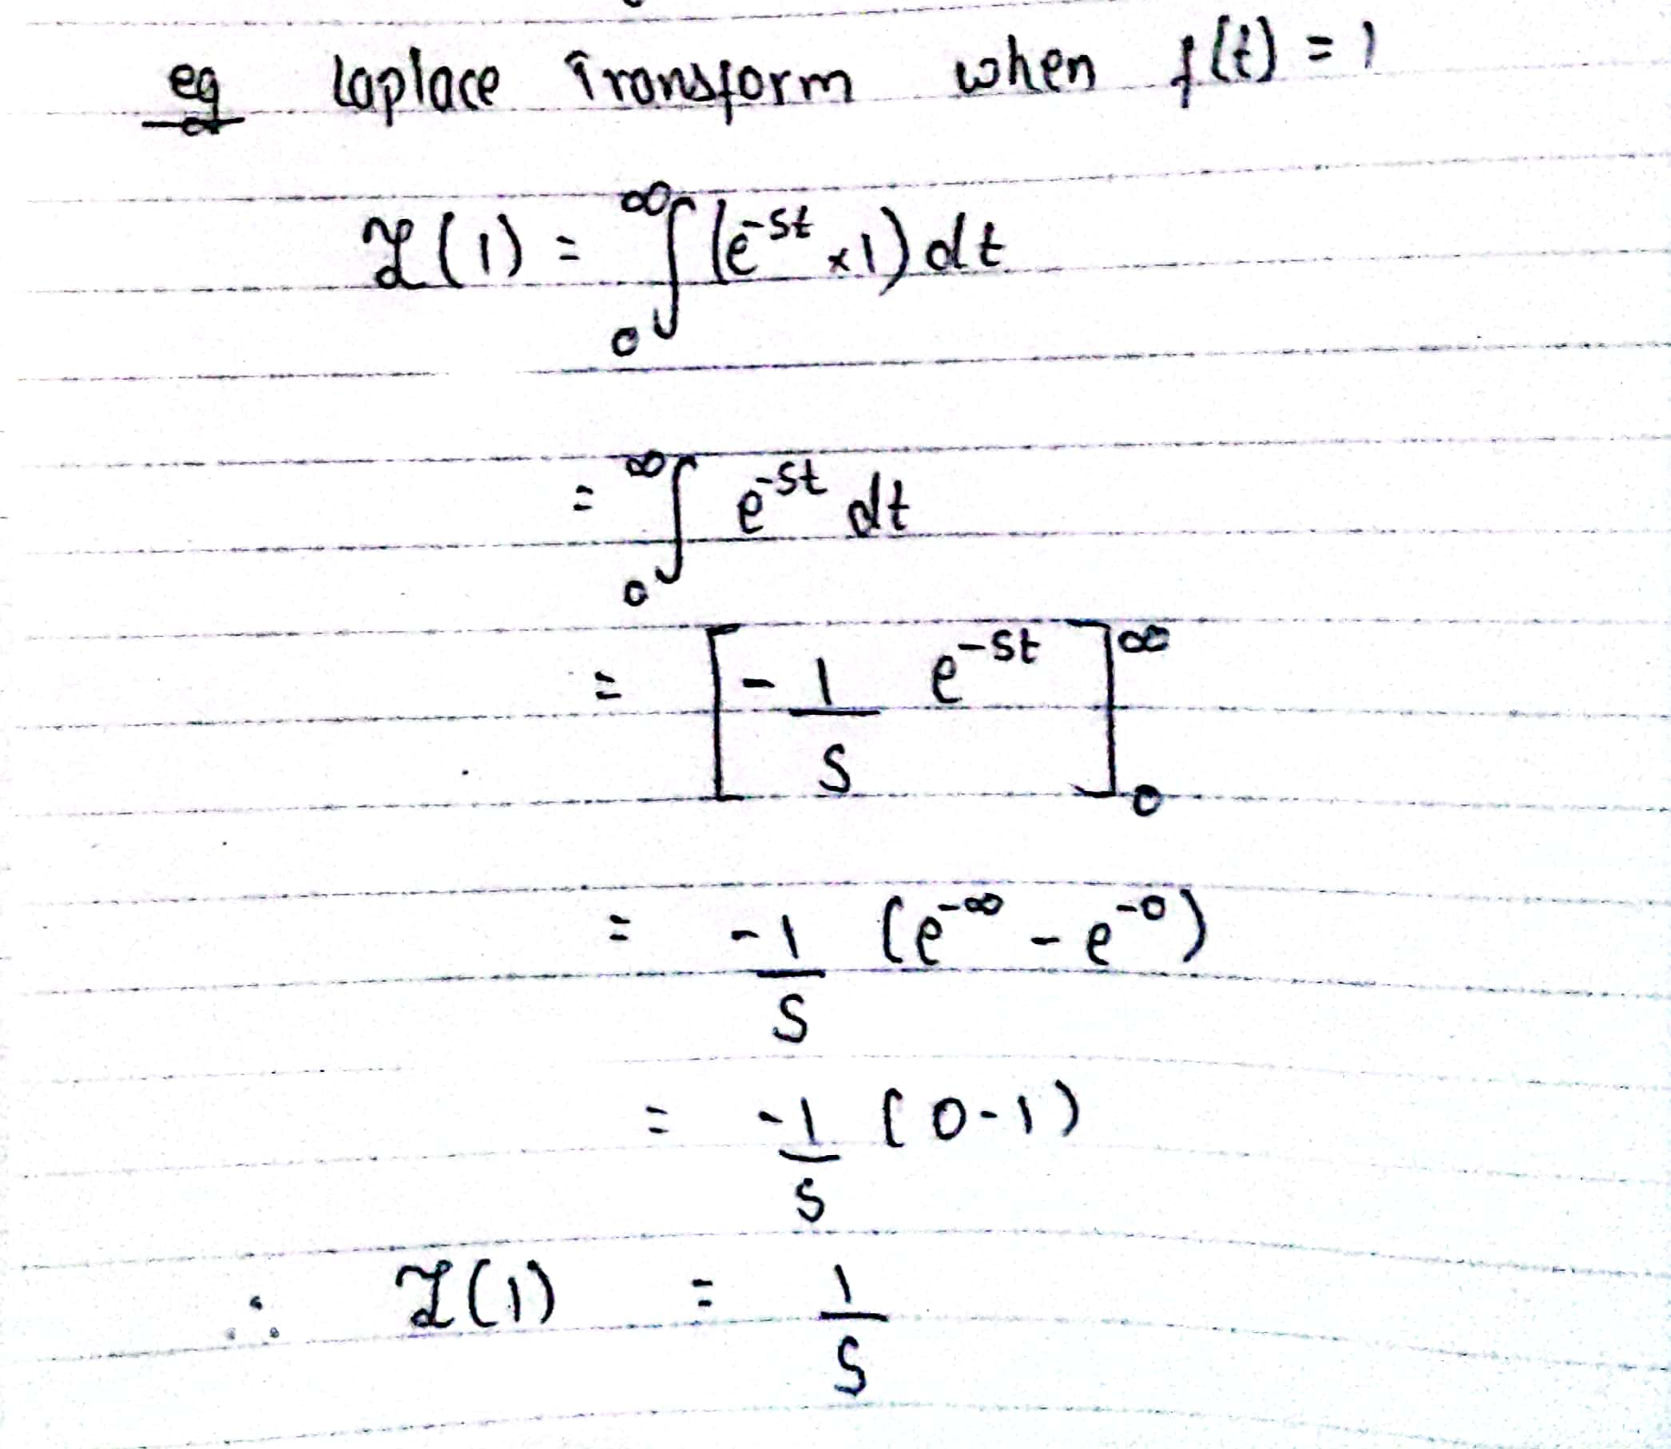

We know,
For all the value of s > 0
F(s) = $\int_{0}^{∞}{f\left(t\right)e^{−st} dt}$
and ℒ {f(t)} = F(s)
Example:

Slide 5

Inverse Laplace Transform
We know,
F(t) = $ℒ^{−1}${F(s)}
So, Inverse Laplace transform of F(t) = $ℒ^{−1}${F(s)}
$ℒ^{ }$(1) = $\frac{1}{s}$
Then,
$ℒ^{−1}$($\frac{1}{s}$) = 1

Slide 6

Fourier transform
Fourier transform is a transformation technique which transforms signals from continuous-time domain to the corresponding frequency domain and vice-versa.
It is used for : X-ray diffraction , Image processing
Mathematically, the Fourier transform of a continuous-time signal 𝑥(𝑡) is defined as

Slide 7
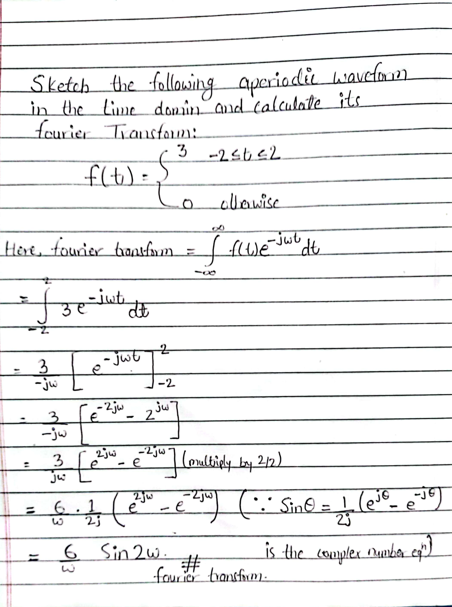
Example:

Slide 8
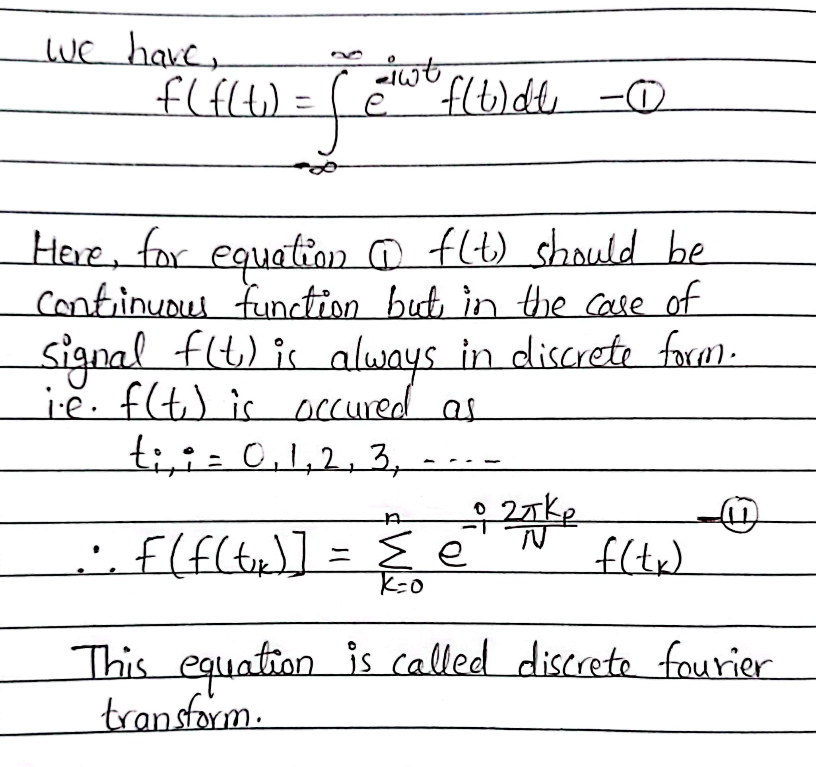
Discrete Fourier Transform
To deal with sampled values rather than with functions, we can replace the Fourier transform by DFT.
Telecommunication, time series, simulation problems .

Slide 9
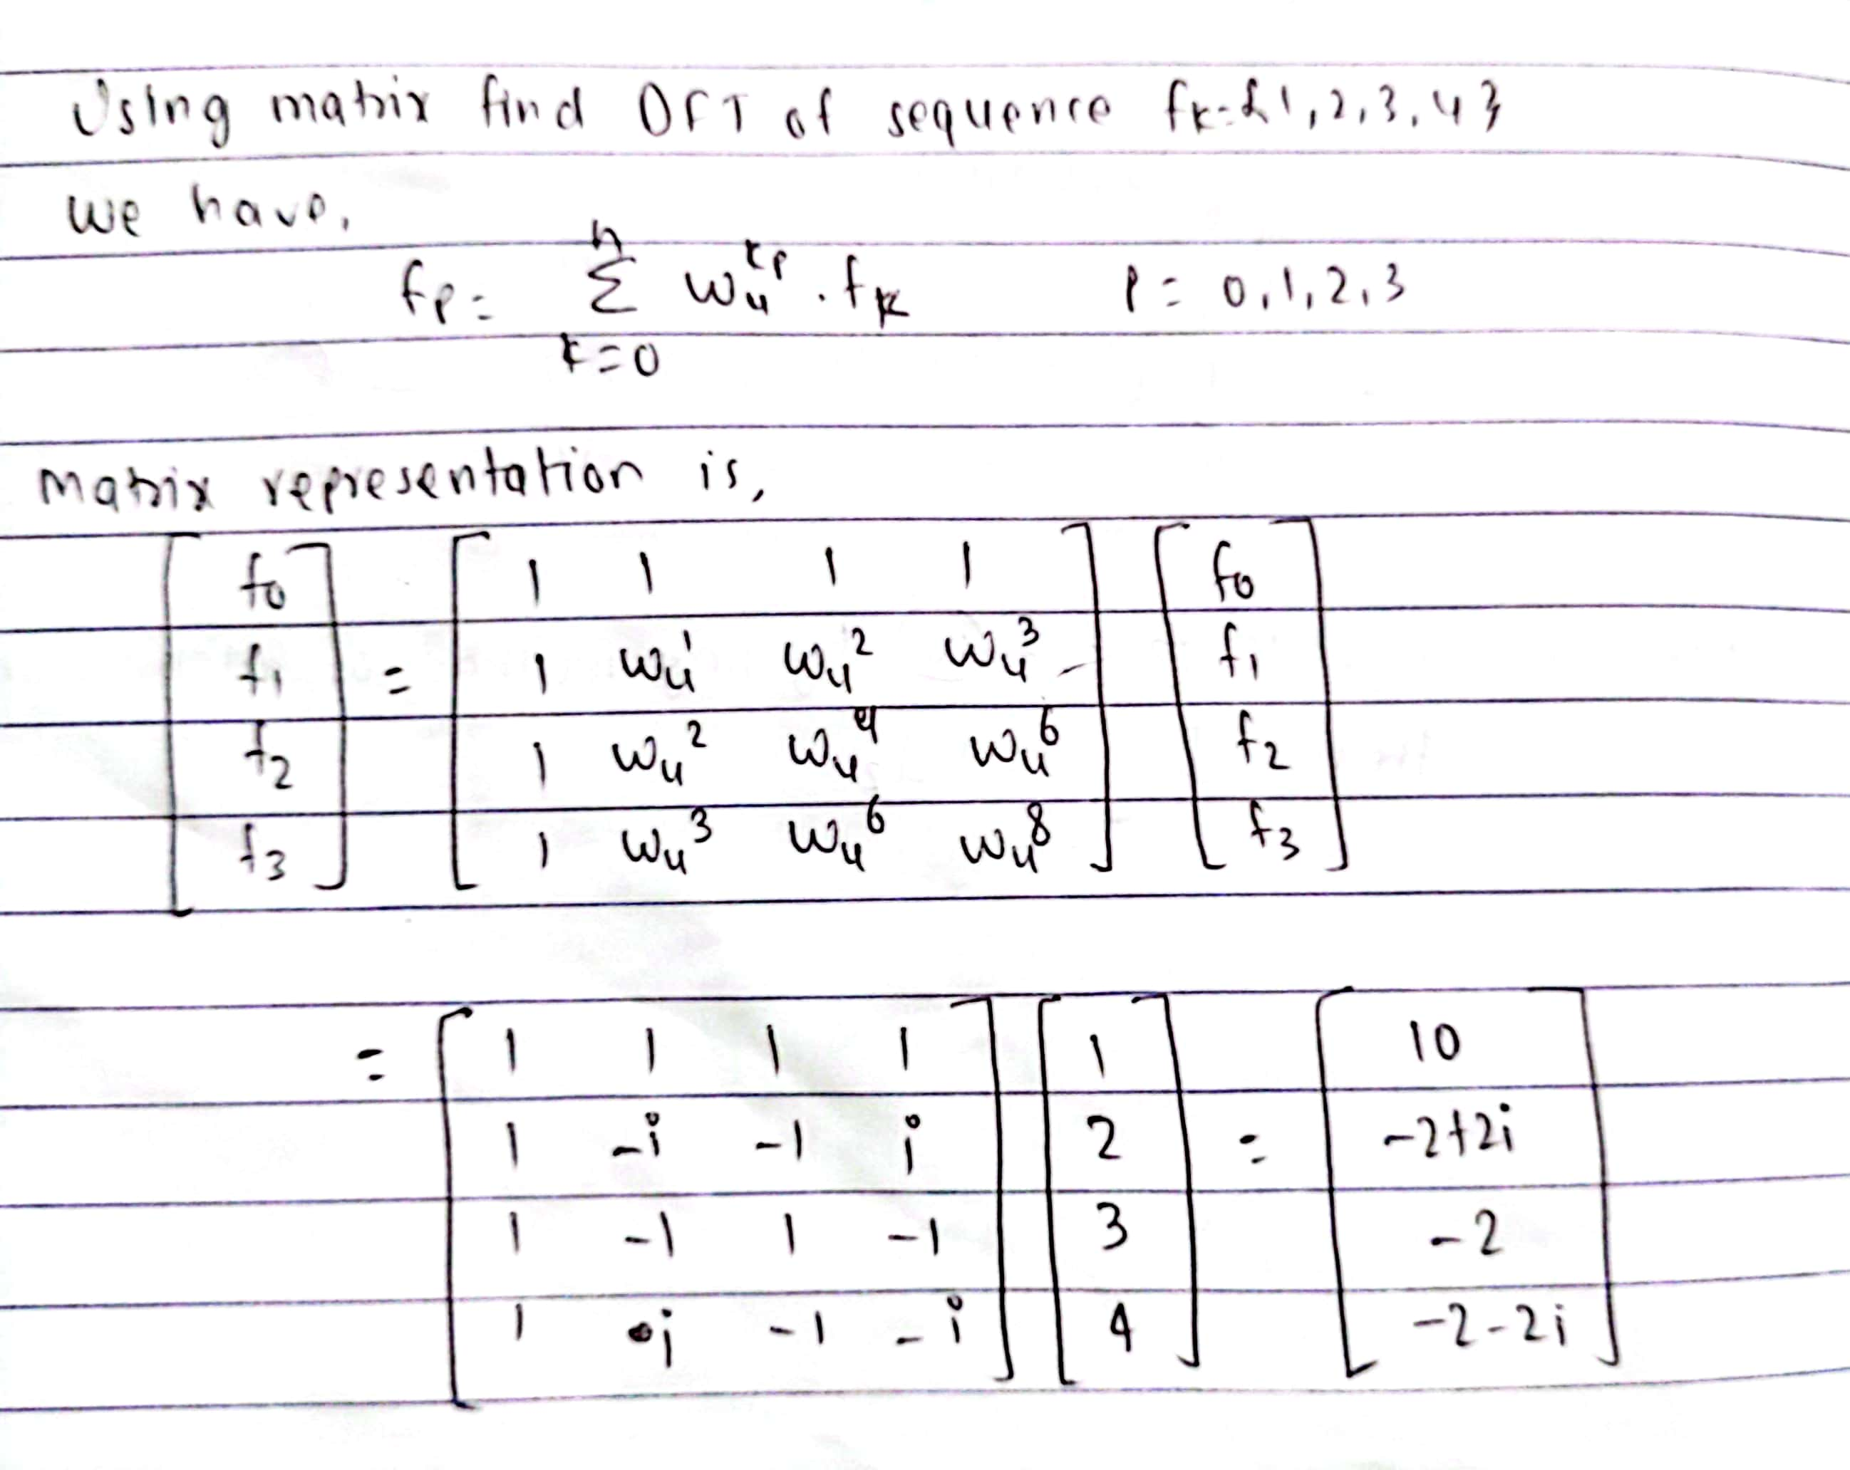
Example of Discrete Fourier Transform

Slide 10
Fast Fourier Transform
FFT is a algorithm that compute discrete Fourier transform of sequence of signal or data.
It is described first in Cooley and Tukey’s classic paper in 1965, but the idea actually can be traced back to Gauss’s unpublished work in 1805. It is a divide and conquer algorithm that recursively breaks the DFT into smaller DFTs to bring down the computation.
As a result, it successfully reduces the complexity of the DFT from O(n2)O(n2) to O(nlogn)O(nlogn), where n is the size of the data
This reduction in computation time is significant especially for data with large N, therefore, making FFT widely used in engineering, science and mathematics.
he FFT algorithm is the Top 10 algorithm of 20th century by the journal Computing in Science & Engineering.

Slide 11
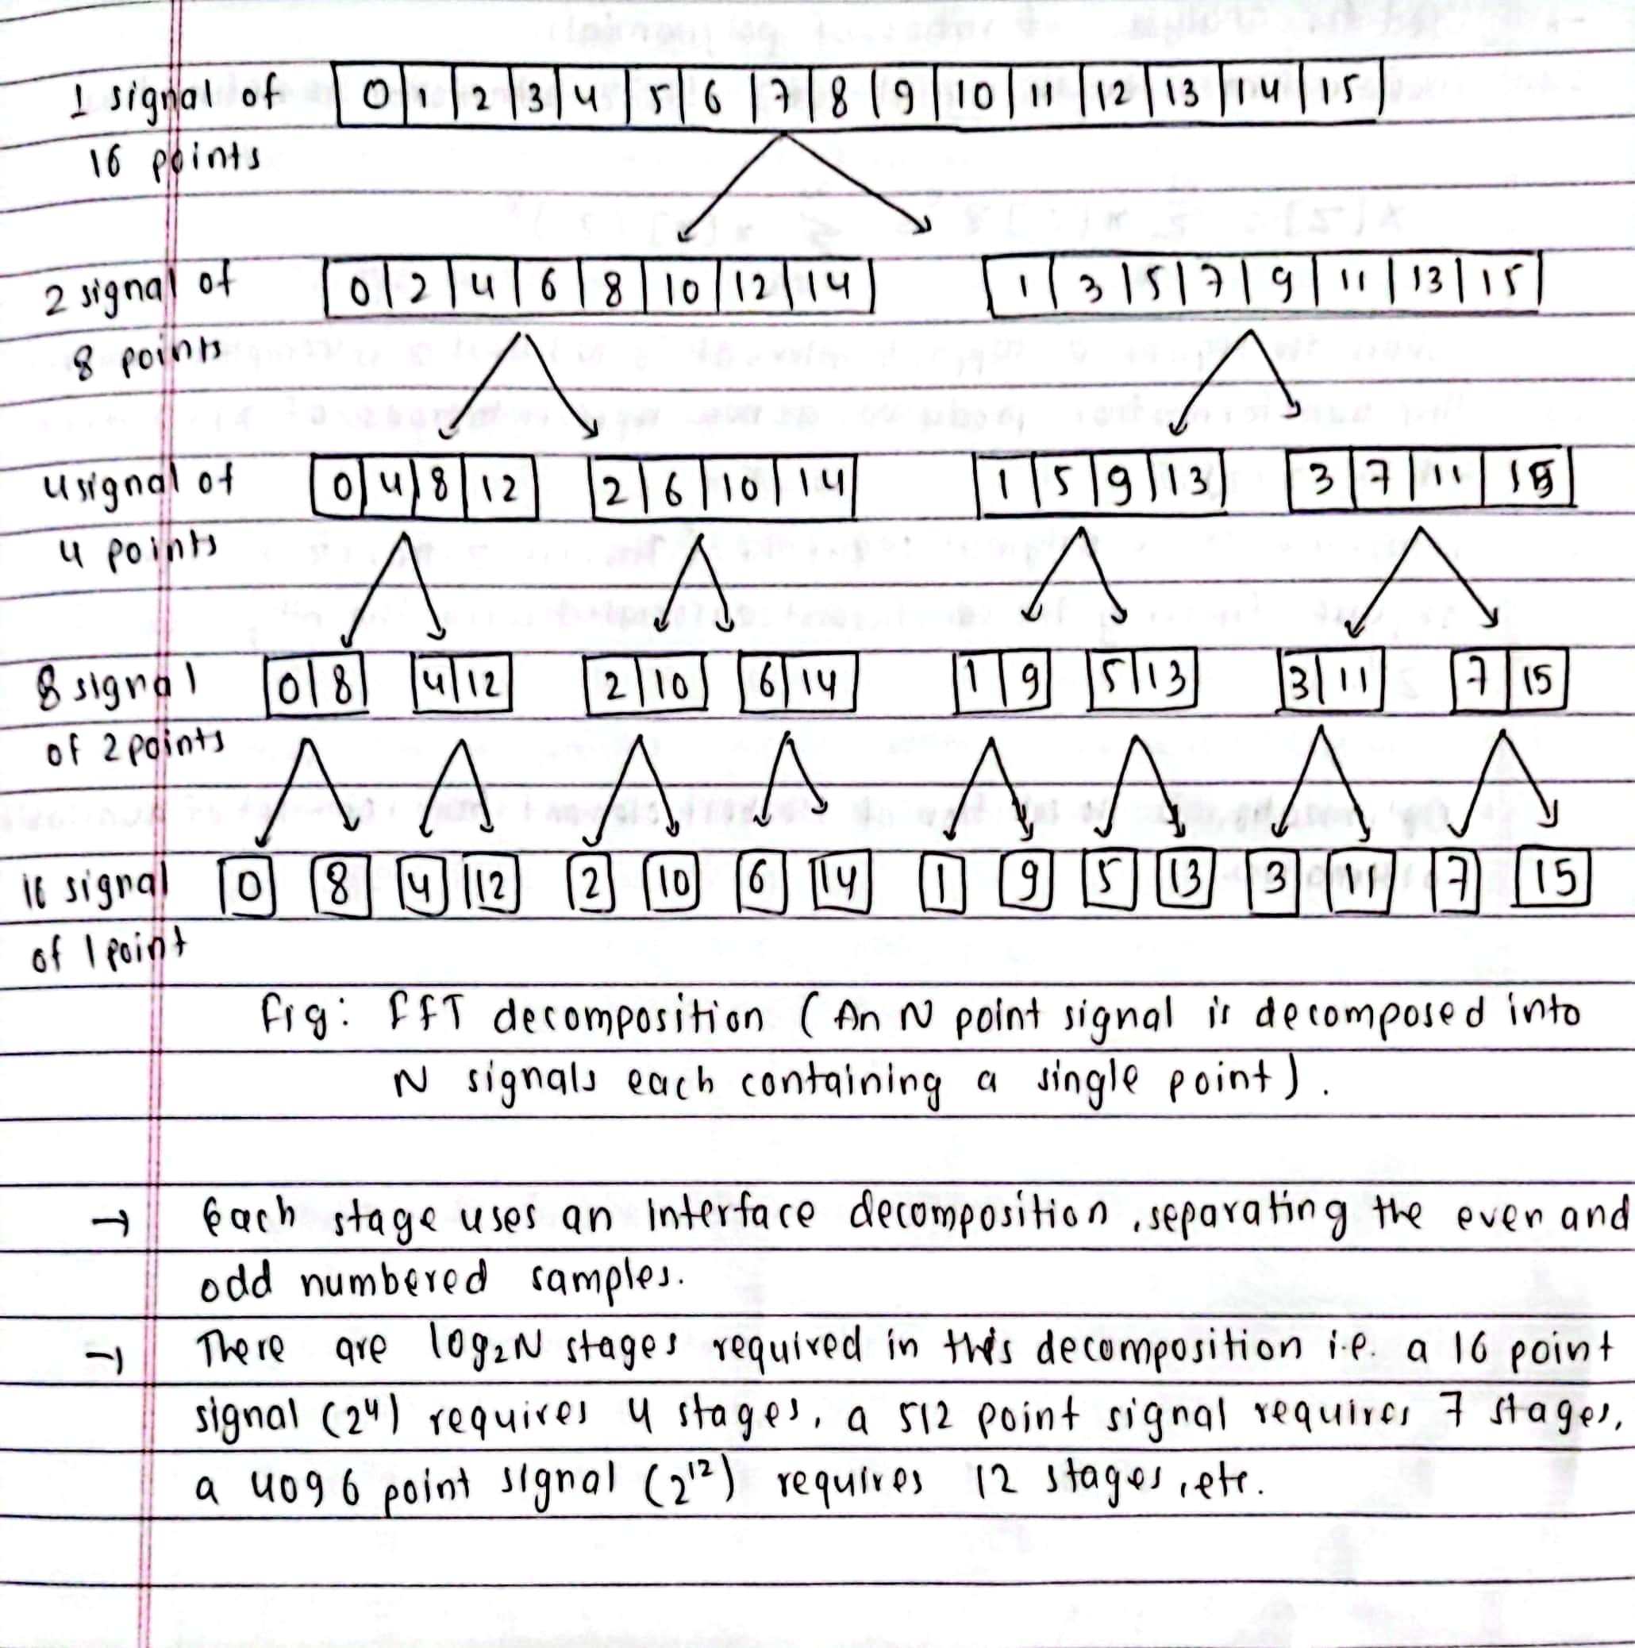
Example of Fast Fourier Transform

Slide 12
Thank You!

